Slide 1


Case Study: Data-Driven Decision Making at Netflix
Explore how Netflix leverages data to drive its success. We will examine its strategies for recommendations, content creation, and customer retention. This analysis highlights the power of analytics.
Smit Mevada
Notes:
1

Slide 2

Introduction to Netflix's Data Strategy
Global Streaming Leader
Core Data Applications
Netflix boasts over 200 million subscribers worldwide.
Data drives show recommendations and content decisions.
It dominates the streaming market.
It also enhances user retention.
Notes:
2

Slide 3


Challenges Addressed by Data
User Engagement
Keeping viewers hooked on the platform was critical.
Netflix needed innovative solutions.
Reducing Churn
Minimising subscription cancellations was a major goal.
Data provided key insights.
Content Selection
Choosing original content with high success potential.
This required predictive accuracy.
Notes:
3

Slide 4
Key Data Points Collected
Interaction Data
Preference Data
Viewing history and session duration.
Device and time preferences are tracked.
Search terms and click paths are vital.
Likes, dislikes, skip, and rewatch behaviour.
Netflix collects comprehensive data. This data forms the backbone of their analytics. Every interaction is a valuable data point.
Notes:
4

Slide 5





Advanced Data Techniques Utilised
Recommendation Algorithms
Collaborative filtering suggests personalised content.
It matches users with similar tastes.
A/B Testing
Layouts and suggestions are continuously tested.
This optimises user experience.
Predictive Analytics
Content production relies on future trends.
Data forecasts success.
User Clustering
Users are segmented for targeted marketing.
This enhances campaign effectiveness.
Notes:
5

Slide 6
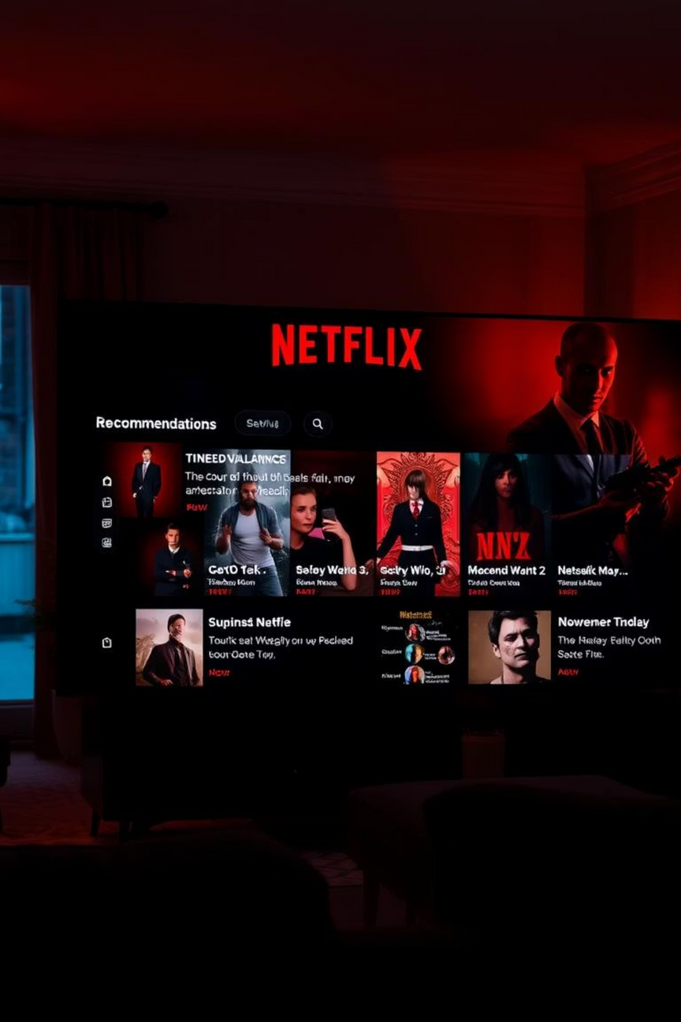


The Power of the Recommendation System
Next Watch Suggestions
System suggests relevant content based on history.
This keeps users engaged longer.
Increased Engagement
Auto-play and dynamic thumbnails boost viewing.
Users spend more time on the platform.
The recommendation engine is Netflix's secret sauce. It continually refines suggestions, driving higher user satisfaction.
Notes:
6

Slide 7
Data-Driven Content Decisions
House of Cards Example
1
Reduced production risks.
Netflix greenlit the show based on data.
User interest in politics, Kevin Spacey, and David Fincher aligned.
2
Higher success rate for originals.
This data-driven approach validated the investment.
3
Optimised content portfolio.
Notes:
7

Slide 8

Retention and Personalisation
1
Personalised Notifications
Push notifications and emails are tailored to users.
They promote new content and re-engagement.
2
Auto-Download Feature
Shows are downloaded based on viewing habits.
This enhances offline convenience.
3
Tailored Home Screen
Personalised trailers and top-picks greet users.
This ensures relevant content discovery.
Notes:
8

Slide 9
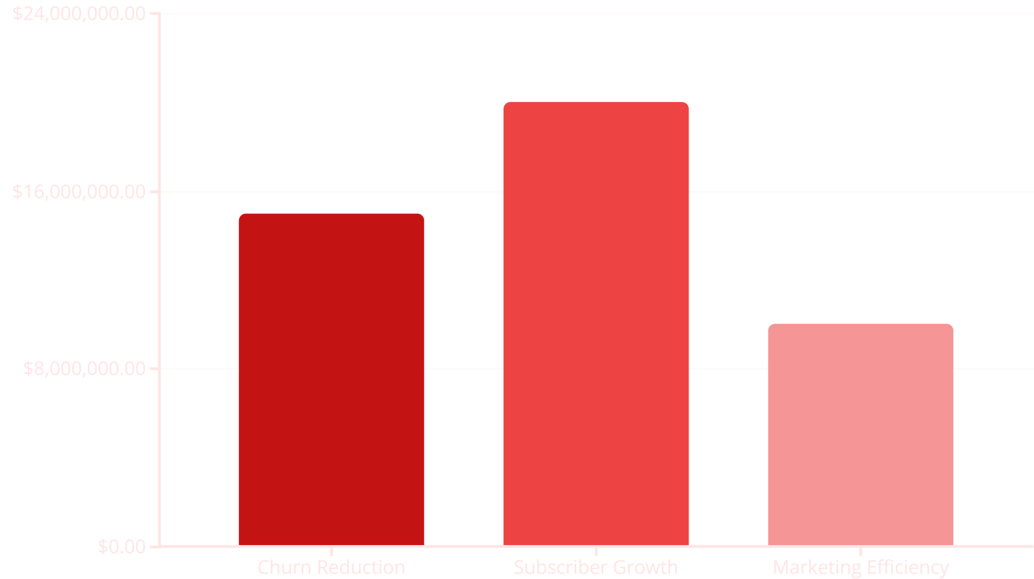
Tangible Business Impact
Netflix achieved significant business improvements. Churn rates decreased, and subscriber growth surged. Marketing and production budgets became more efficient.
Notes:
9

Slide 10
Conclusion: Data as a Competitive Edge
1
Strategic Analytics
Netflix's core strength is its data usage.
2
Informed Decisions
Smart analytics lead to better choices.
3
Global Success
This drives their worldwide dominance.
Netflix's journey illustrates data's transformative power. Their success serves as a benchmark for data-driven enterprises globally.
Notes:
10

